Slide 1
Lab Exercises

Slide 2
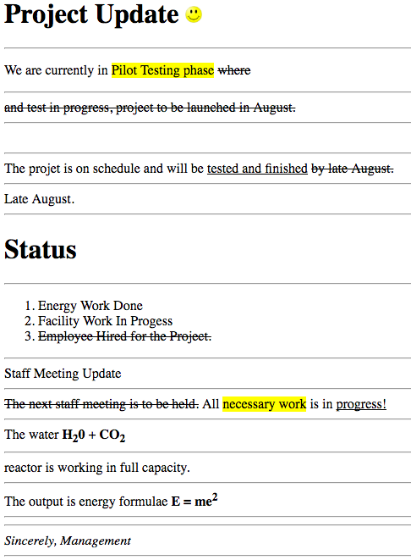
1. Write an Html code that display the following web page content

Slide 3
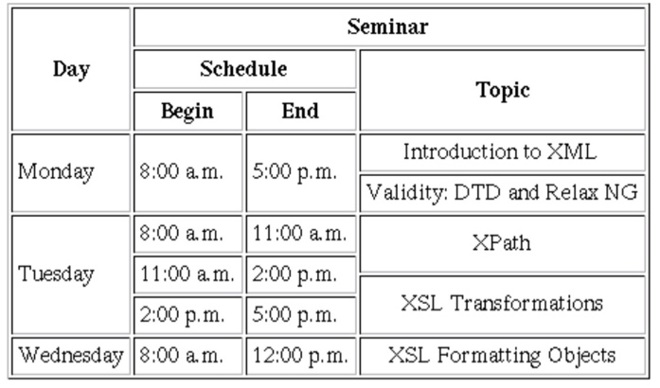
2. Write an Html Code that produce the following

Slide 4
3. Create an image that composed of various Ethiopian Universities logo and then create image map to navigate to the official site of the Universities.

